Slide 1
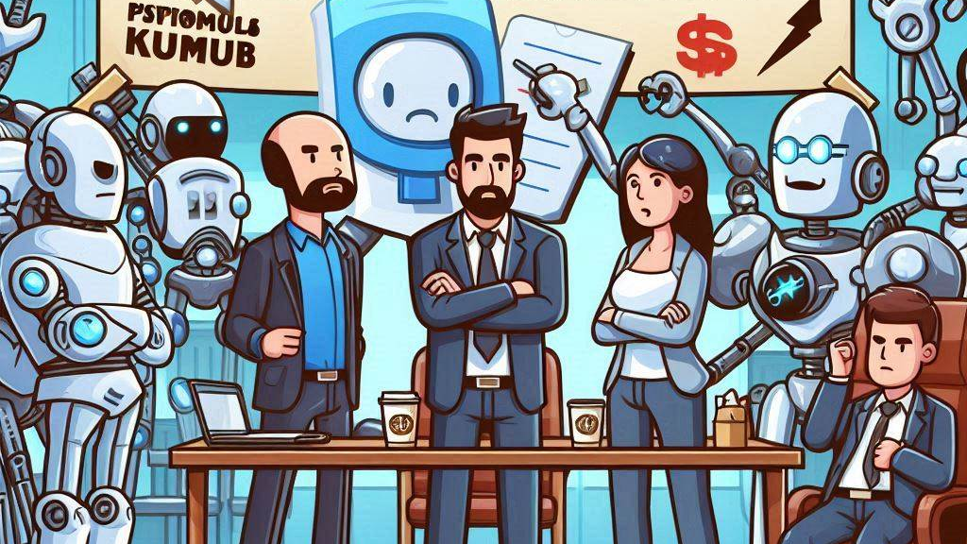
Product Managers against humanity
Notes:
When Lemon reached out to me to speak at PubConf, I though what any sensible person would think… Hell no I’m not going to do that!

Slide 2

Notes:
But then, after having had a few drinks one evening… Yes, that one time I had a few drinks… Angelique convinced me to join, and as Todd has taught me, what you say when you are drunk, you have to do when you’re sober, that will teach me to keep my big mouth shut.

Slide 3

Notes:
So now here I was, thinking about what our world will look like in 2034, and so I started thinking about an ideal world… A world where I don’t have to interact with people!

Slide 4
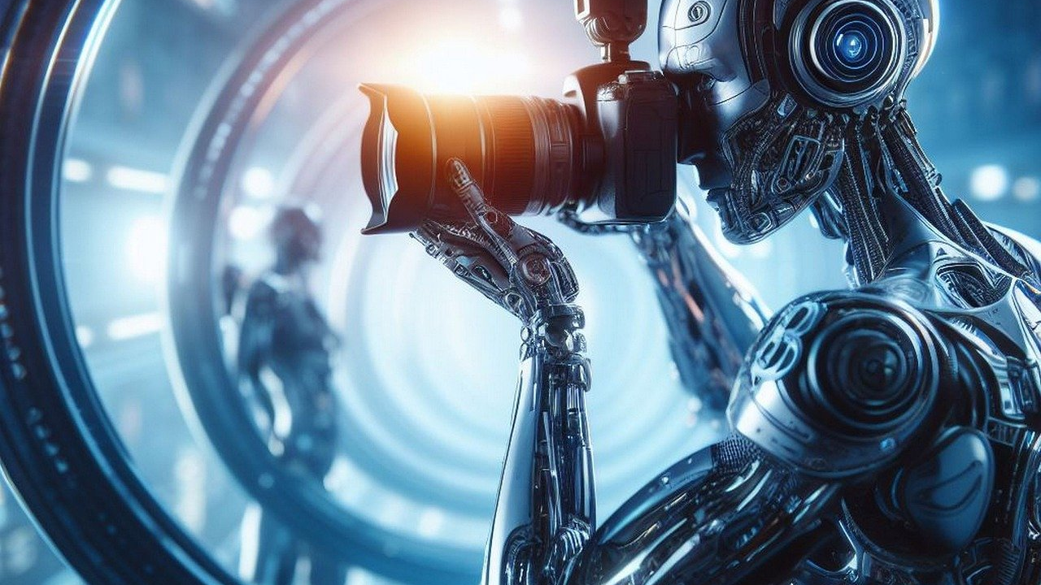
Notes:
Luckily, AI is about to take over the world! As some of you might know, I am the program manager for Azure Service Bus, and not having to deal with people would make my life so much easier.

Slide 5

Notes:
First of all, we can finally get rid of our engineering team. Most of my day is making sure that my engineering team focus on building the features I tell them to, instead of silly stuff… like making sure our service keeps running without any interruptions. Don’t they know about all these GitHub issues we need to close?

Slide 6
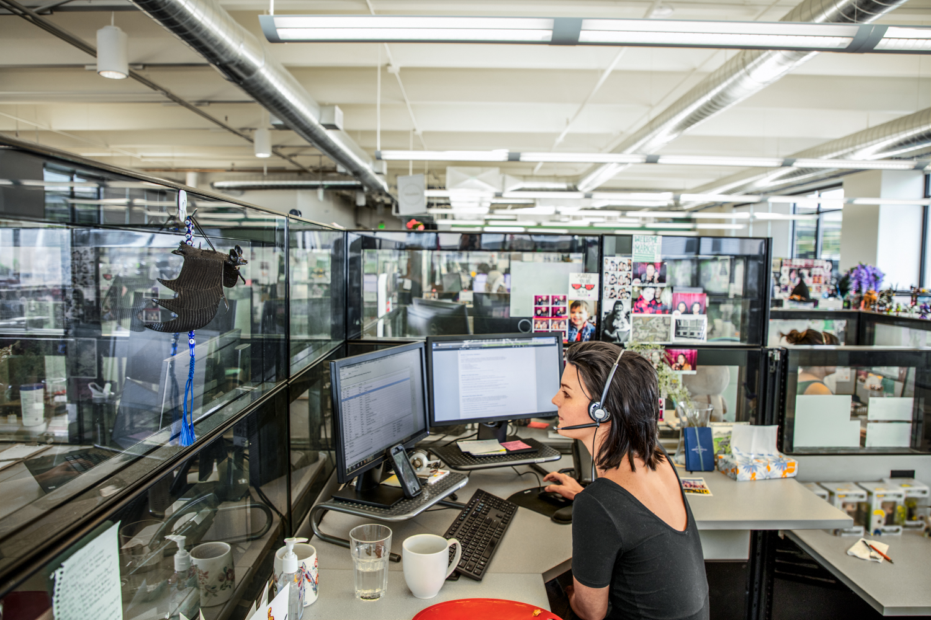
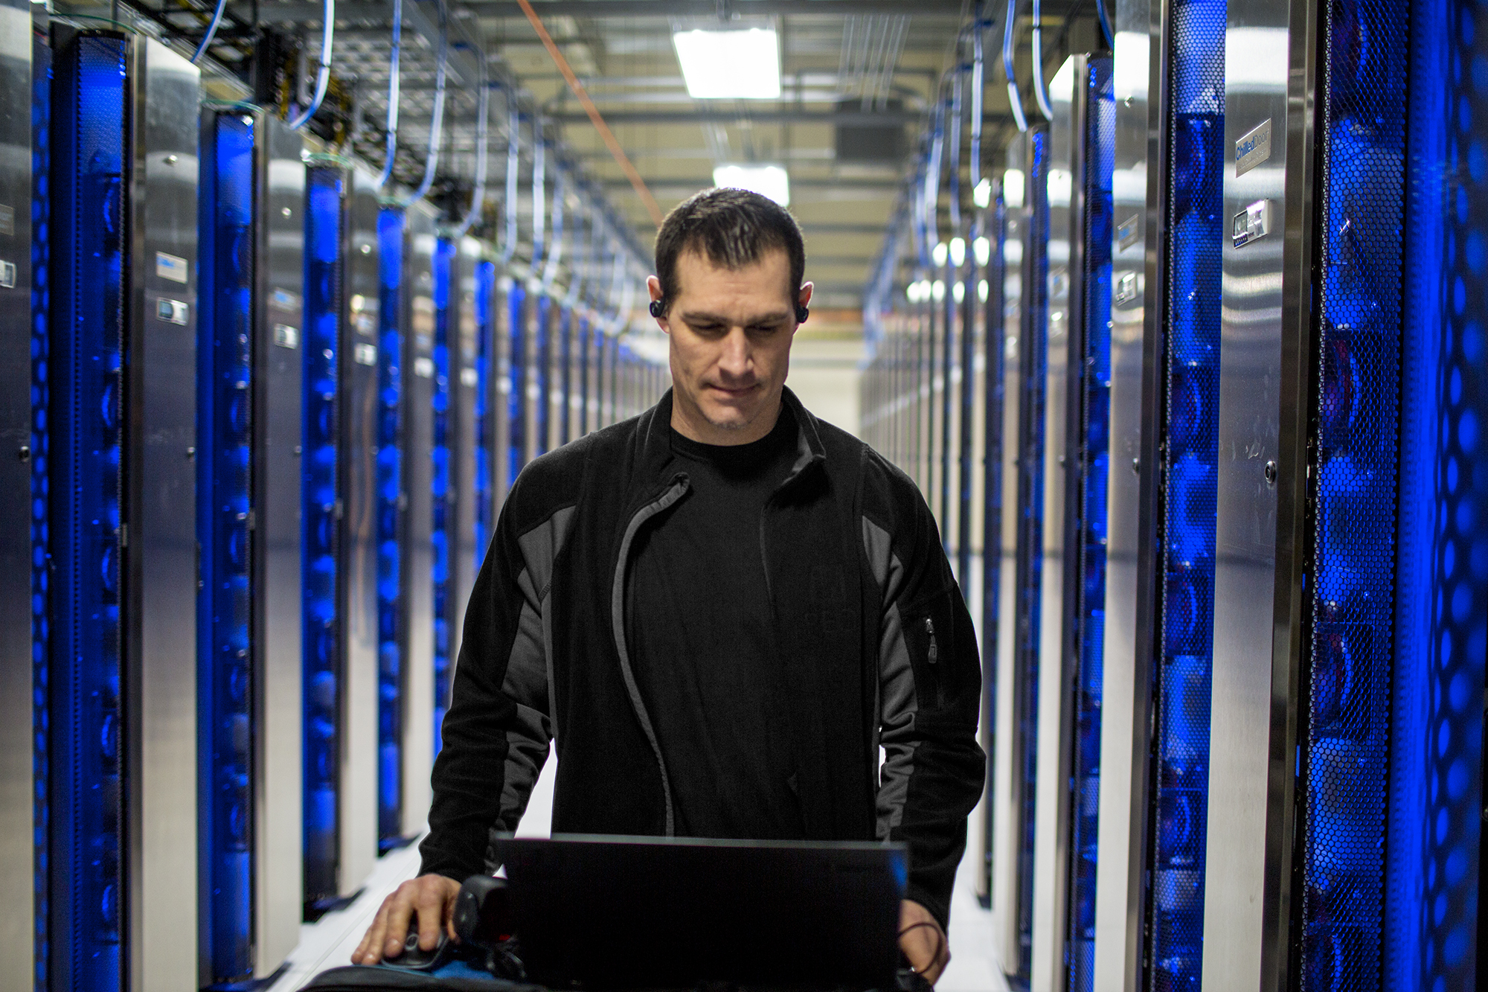



Azure Messaging and Streaming Scale
99.9992%
Weekly success rate across messaging
>305.2 T
Monthly Requests across messaging
>475 PB
Monthly data volume (egressed)
>1.45 M
Unique Streaming Jobs processed per month
>77.5 K
External Messaging customers
>75,000+
VMs run our services
>10.6 T
Peak requests/day into messaging
>2.08 TB
Per minute written at peak written to storage by Event Hubs Capture
>13.28 T
Streaming Events processed monthly
100%
Of the top 500 Azure customers use messaging services
Notes:
I mean, all I am asking them is to build a distributed service, that can serve billions of request per month globally, with 99.99 sla and no data loss, and keep adding new features to this. How hard can it be! And yes, another thing that Todd has taught me, is that it’s okay to use PubConf to promote your own products.

Slide 7

Notes:
And thanks to CoPilot, I can now just tell the AI what I want to build, and it will generate everything for me. And we all know that AI is infallible, so as a good program manager I can now push this directly into our production systems.

Slide 8
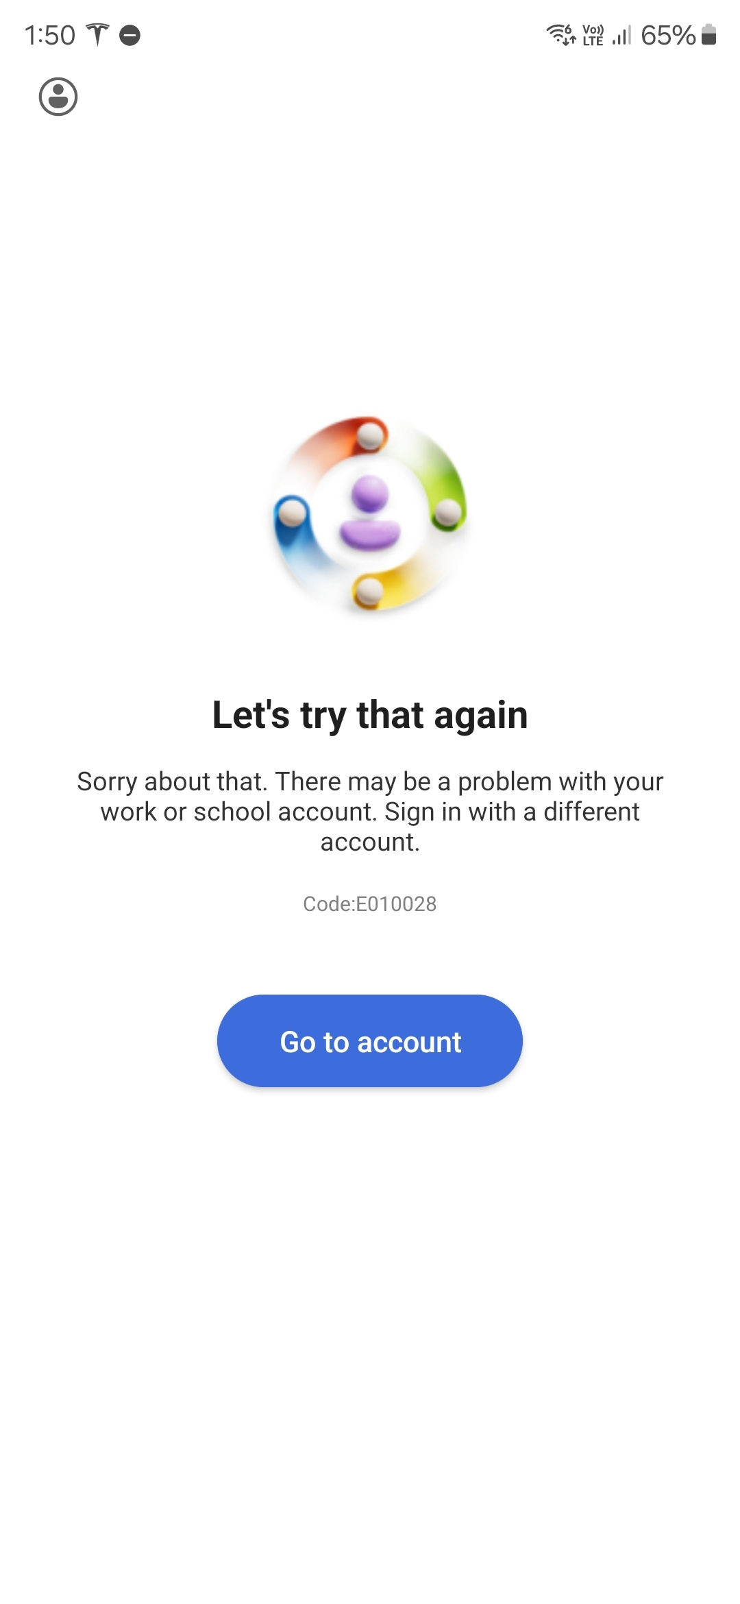
Notes:
I can’t wait to have my little army of AI engineers. They might still not do what I want, but at least I can just reboot them when I get annoyed. Or in the case of CoPilot, just wait for it to hang up on itself.

Slide 9
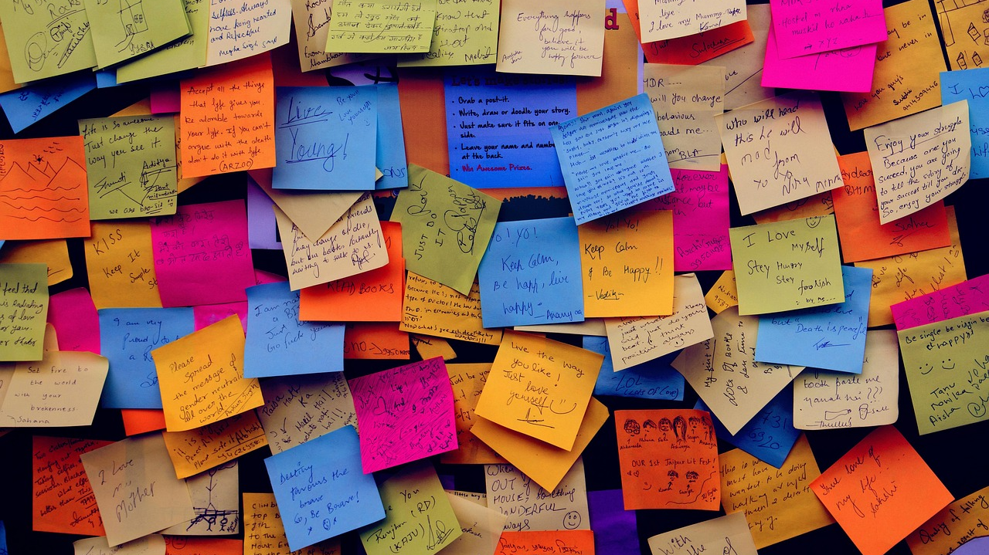
Notes:
Next, let’s talk about customers! Building a service would be so much easier if we didn’t have all these customers. They take up so much of my time, that I could be spending on making our SCRUM board look nice!

Slide 10
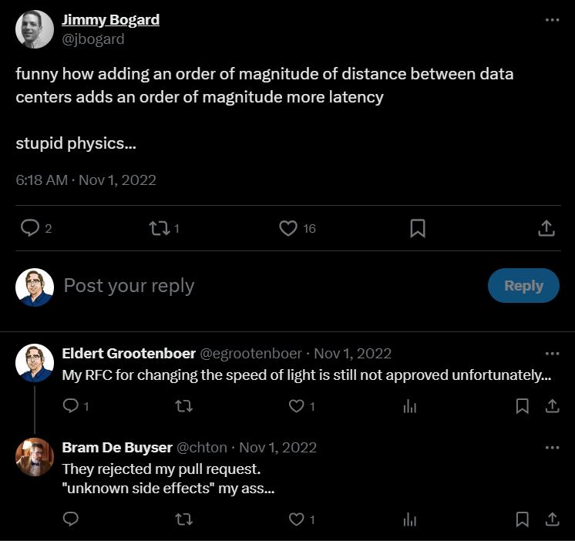
Notes:
For example, we are building a geo-replication feature, and now I have to try and explain them that no, we can not give you 10 milliseconds of latency between Australia and Europe! I tried to put in the pull request to break the speed of light, but apparently we are not allowed to change the laws of physics.

Slide 11
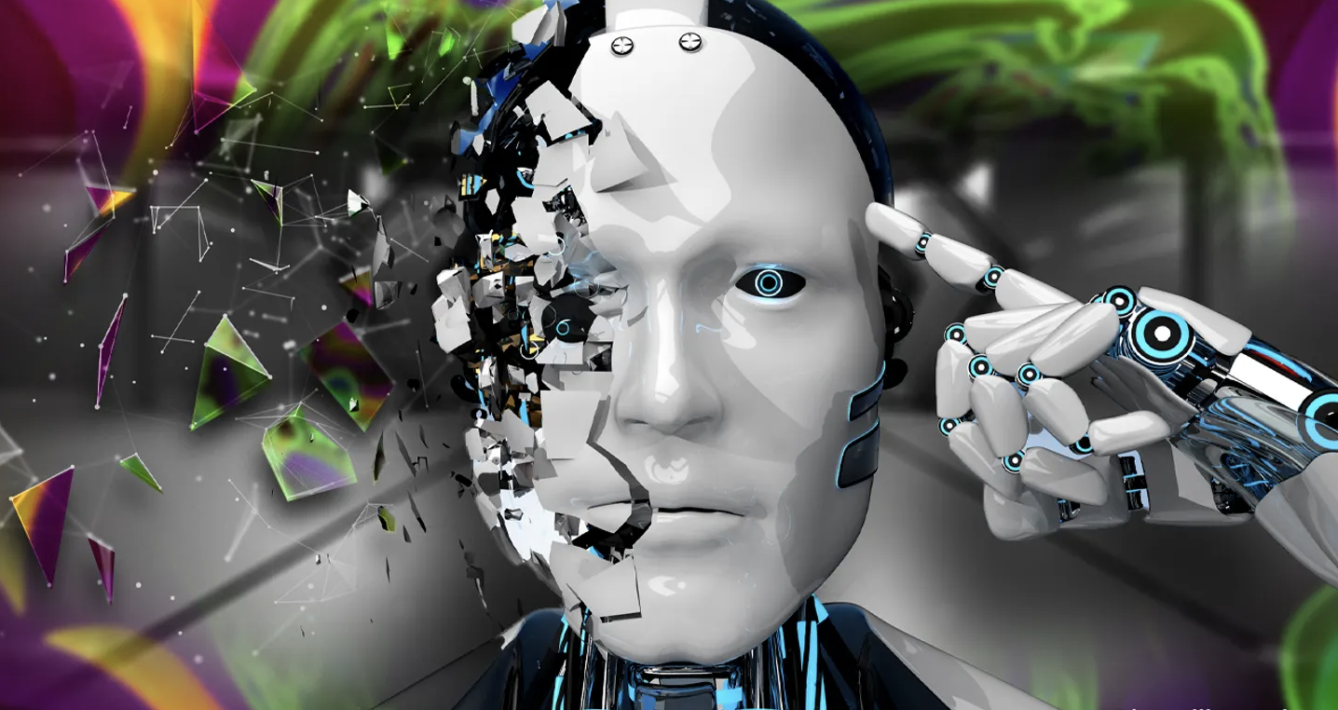
Notes:
Another great pastime of mine is getting on a customer call because they have seen a 5 second hiccup, and now they want to get a 70 page RCA, signed by Satya himself. Let’s replace all our customers with AI, so at least I know I can expect them to be hallucinating.

Slide 12
Notes:
And of course, then there is the community. Yes, that means all of you! You didn’t think you would get away so easily, now would you?

Slide 13

Notes:
First of all, as a speaker, there is nothing just like spending weeks on building a session, doing dry runs, fly over half the country or even world, spend an hour on stage giving all our best. And then, when it’s time for you to provide your feedback…

Slide 14

Notes:
You give a negative rating because the temperature is not right! Look, I can’t help that the organizers decided to run this event on the surface of the sun. There is enough in my session for you to complain about without resorting to complaining about the climate.

Slide 15
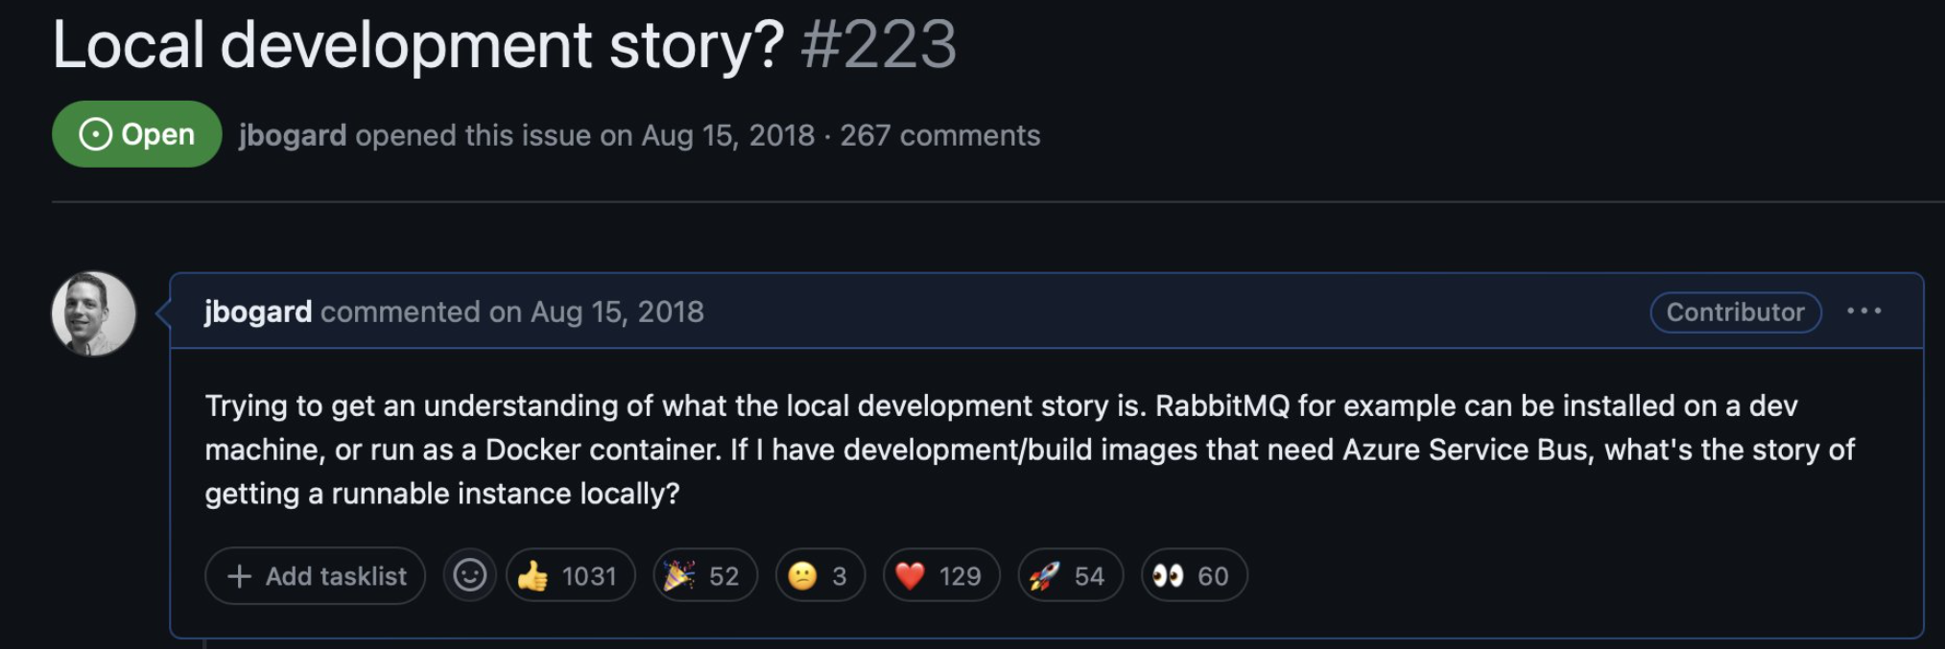
Notes:
And why do you all think you can keep asking us for features that would make sense? Don’t you know I have Power BI reports to build? I don’t have time to look at these! Go build some more open source products and leave me alone.

Slide 16
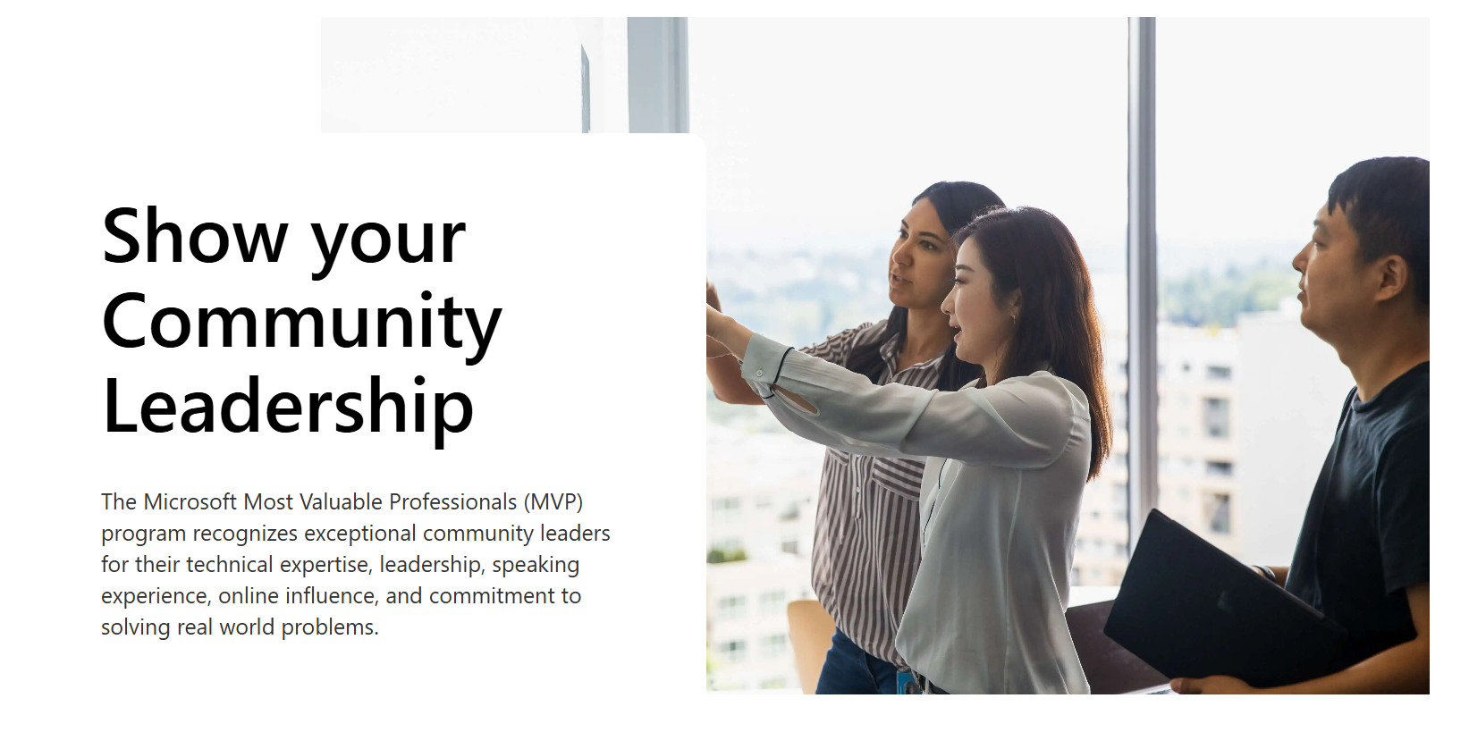
Notes:
Don’t get me wrong though, I do love our community, and as Microsoft, I especially love our MVPs. I get to ask them for feedback, and share NDA information with them.

Slide 17
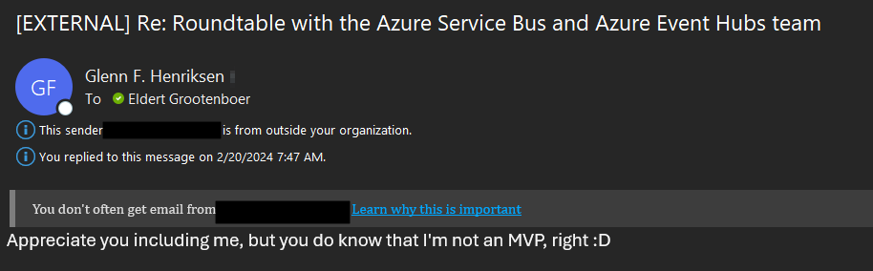
Notes:
And then they have the audacity to tell you that they are not even an MVP! So rude…

Slide 18
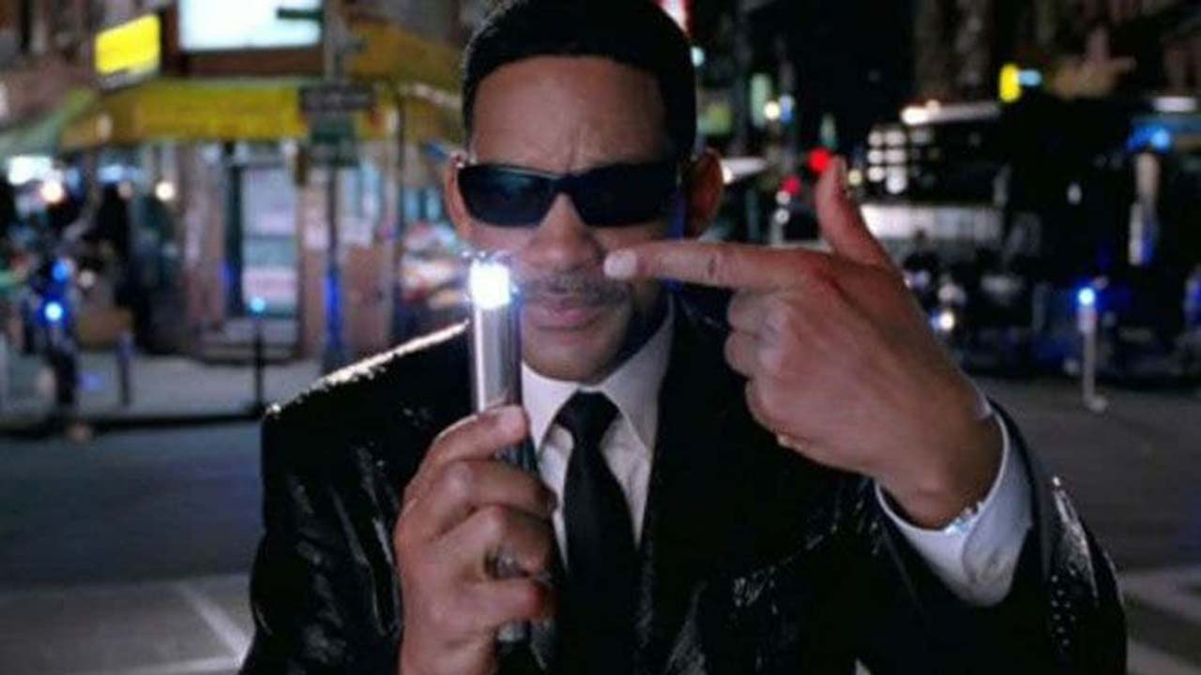
Notes:
So now I have to go all Men in Black on him and erase his memory… Now, I don’t have a flashing light to erase any memories, but I do have other ways to make people forget things.

Slide 19

Notes:
Which reminds me, Glenn, can you please order a couple of drinks for the both of us?

Slide 20

Notes:
And this is why I can’t wait for AI to take over. By the way, you might be thinking, am I not afraid of AI to take over my job? Nah, because for artificial intelligence to take over, there has to be some intelligence needed for the job first! Thank you!

